Slide 1
Typical applications areas are
GUI • Plotting in business
Office automation • Desktop publishing
Plotting in science and technology
Web/business/commercial publishing and advertisements
CAD/CAM design
(VLSI, Construction, Circuits)
Scientific Visualization

Slide 2
Entertainment
(movie, TV Advt., Games etc.)
Simulation studies •
Cartography •
Simulators
Multimedia
Virtual reality
Process Monitoring
Digital Image Processing
Education and Training

Slide 3
GUI – Graphical User Interface
Typical Components Used:
Menus
Buttons
Icons
Valuators
Cursors
Grids
Dialog Boxes
Sketching
Scroll Bars
3-D Interface

Slide 4
CRT DISPLAY DEVICES

Slide 5
Examples of Computer Graphics Devices:
CRT, EGA/CGA/VGA/SVGA Monitors, plotters, data matrix, laser printers, Films, Flat panel devices, Video digitizers, Scanners, LCD panels, Keyboard, Joystick, Mouse, Touch screen, Track ball etc.
The most commonly used display device is the CRT monitor.

Slide 6
Types of CRT display devices
DVST (Direct View Storage Tube)
Calligraphic or Random Scan Display System
Refresh and raster scan display system

Slide 7
DVST - Direct View Storage Tube
Storage Tube – It is a CRT with a long persistence phosphor
Provides flicker-free display
No refreshing is necessary
A slow moving electron beam draws a line on the screen
Screen has a storage mesh in which the phosphor is embedded
Image is stores as a distribution of charges on the inside surface of the screen
Limited interactive support

Slide 8
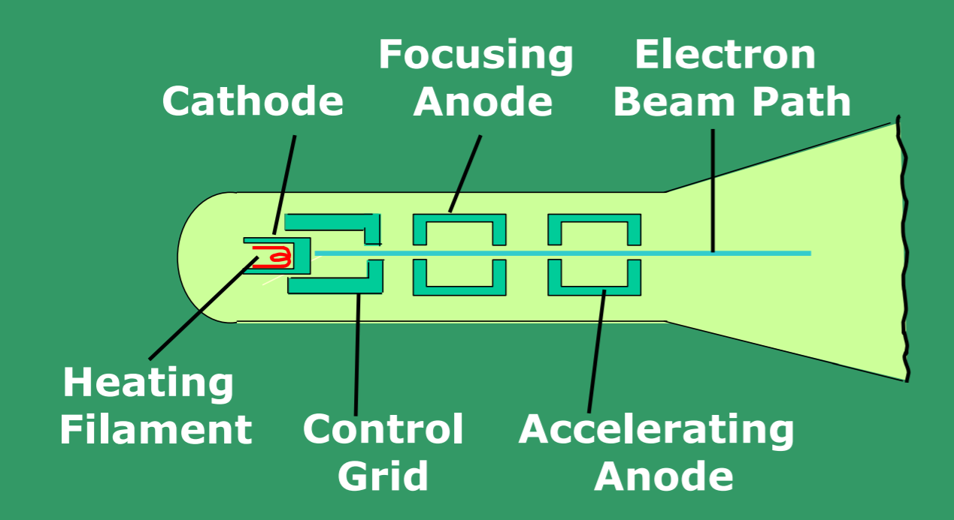
Operation of an electron gun with an accelerating anode

Slide 9
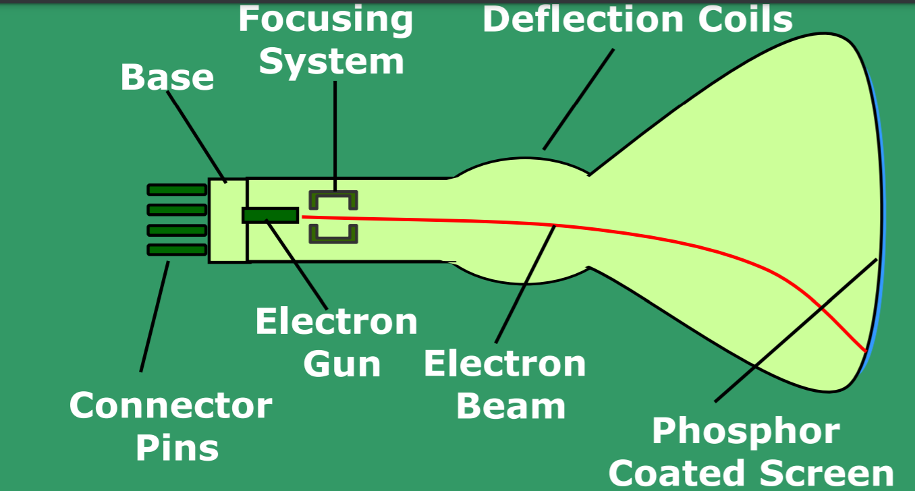
Basic design of a Magnetic deflection CRT

Slide 10
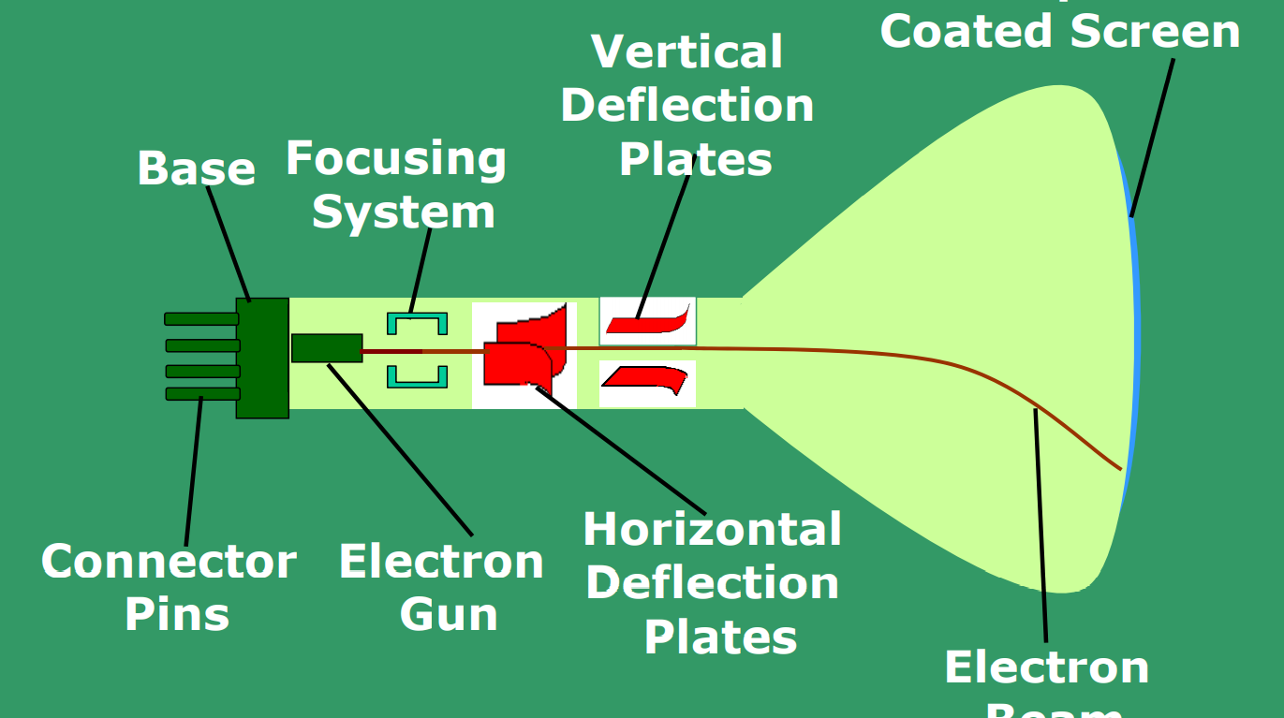
Electrostatic deflection of the electron beam in a CRT

Slide 11
DVST - Direct View Storage Tube (contd.) Drawbacks
Modifying any part of the image requires redrawing the entire modified image
Change in the image requires to generate a new charge distribution in the DVST
Slow process of drawing – typically a few seconds are necessary for a complex picture
Erasing takes about 0.5 seconds. All lines and characters must be erased
No animation possible with DVST

Slide 12
Calligraphic or Random Scan display system
Also called Vector, Stroke, Line drawing displays
Characters are also made of sequences of strokes (or short lines)
Vectored – electron beam is deflected from end-point to end-point
Random scan - Order of deflection is dictated by the arbitrary order of the display commands
Phosphor has short persistence – decays in 10-100 s

Slide 13
Calligraphic or Random Scan display system (contd.)
The display must be refreshed at regular intervals – minimum of 30 Hz (fps) for flicker-free display
Refresh Buffer – memory space allocated to store the display list or display program for the display processor to draw the picture
The display processor interprets the commands in the refresh buffer for plotting
The display processor must cycle through the display list to refresh the phosphor
The display program has commands for point- , line–, and character plotting

Slide 14
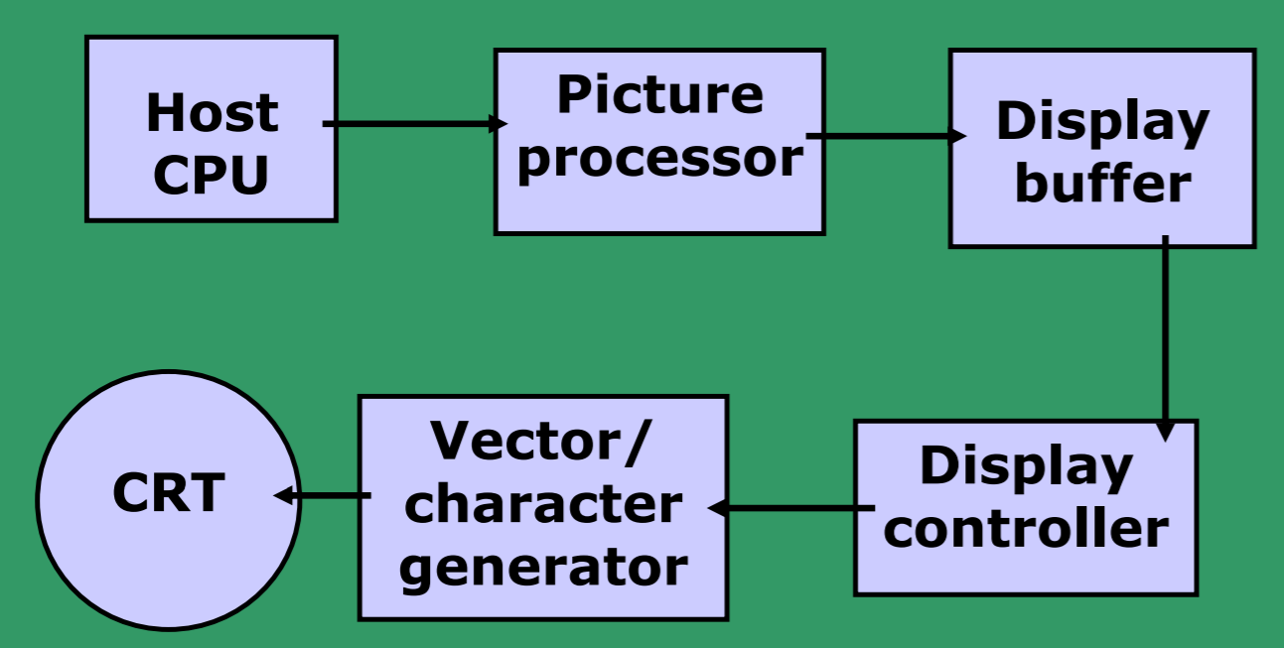
Conceptual block diagram of calligraphic refresh display - I

Slide 15
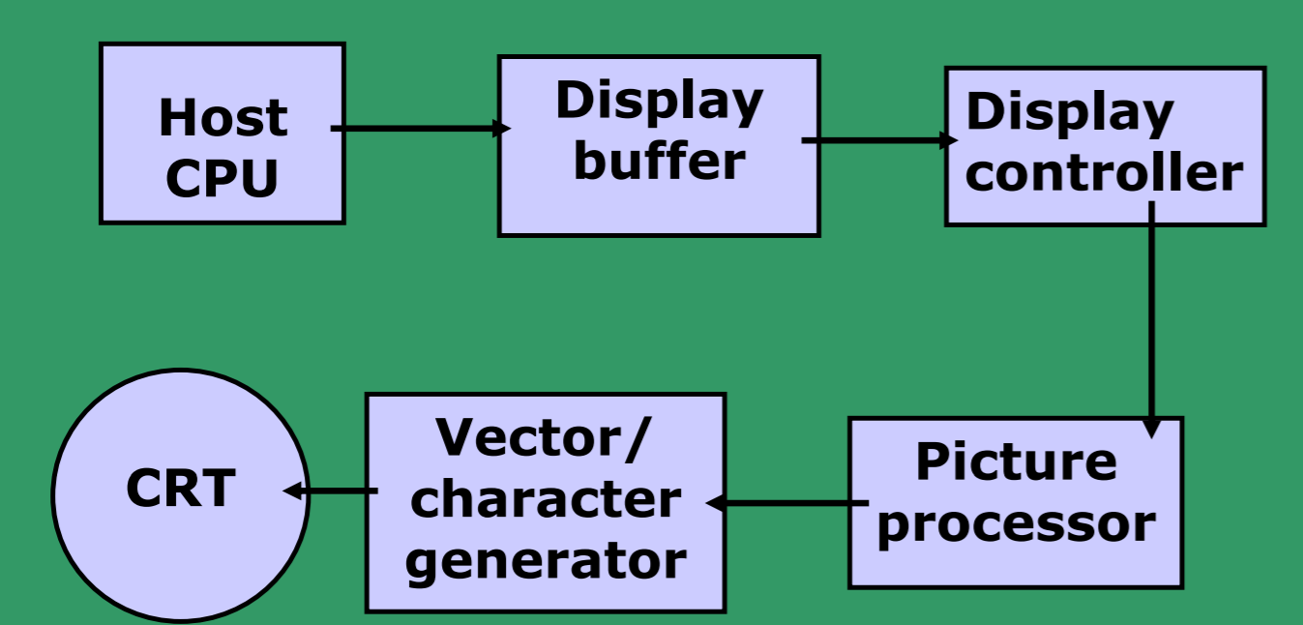
Conceptual block diagram of calligraphic refresh display - II

Slide 16
Calligraphic or Random Scan display system (contd.)
The display processor sends digital and point coordinate values to a vector generator
The vector generator converts the digital coordinate values to analog voltages for the beam-deflection circuits
The beam-deflection circuits displace the electron beam for writing on the CRT’s phosphor coating
Recommended refresh rate is 40 – 50 Hz.
Scope of animation with segmentation – mixture of static and dynamic parts of a picture

Slide 17
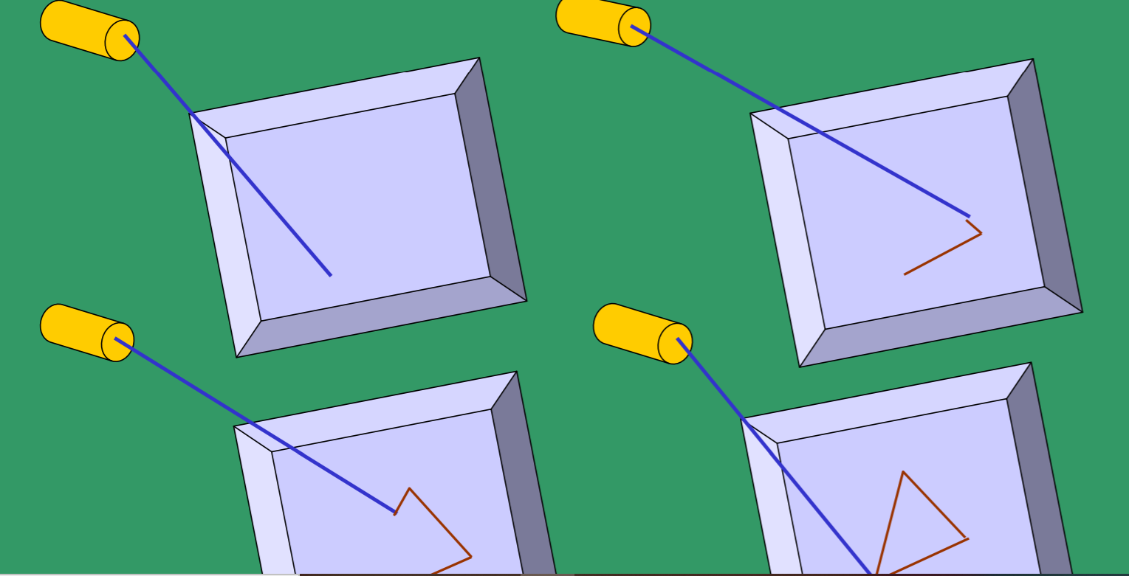
Random-scan display system draws a set of lines in any order.

Slide 18
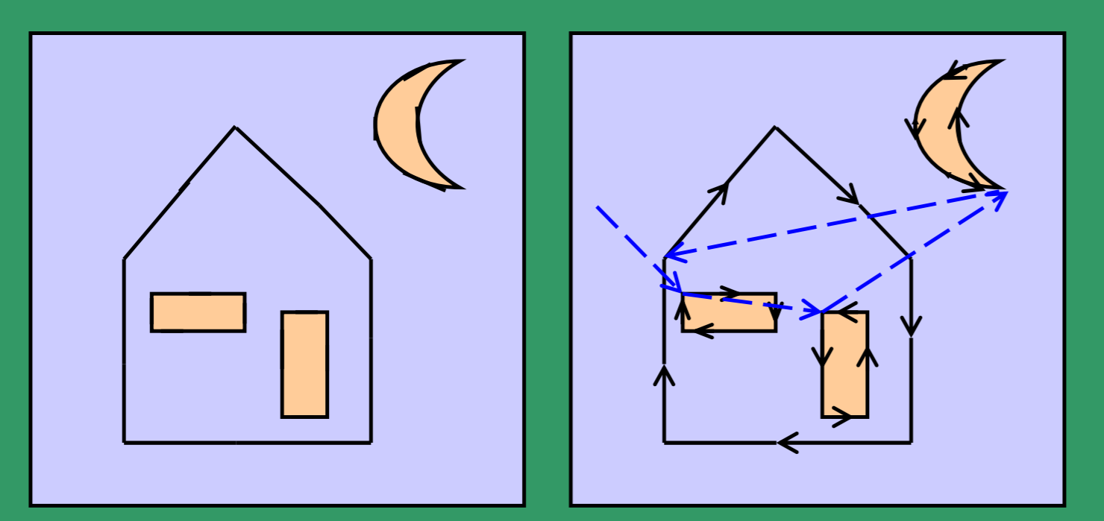
(a) Ideal line drawing (b) Vector scan

Slide 19
Calligraphic or Random Scan display system (contd.)
Phosphor’s Fluorescence is the light emitted as electrons (unstable) lose their excess energy while the phosphor is being struck by electrons
Phosphorescence is the light given off by the return of the relatively more stable excited electrons to their unexcited state once the electron beam excitation is removed
Phosphor’s persistence is defined as the time from the removal of excitation to the moment when phosphorescence has decayed to 10% of the initial light output (decay is exponential).
long persistence : several seconds
short persistence : 10-60 µs (common in modern displays)

Slide 20
Refresh and raster scan display system
Used in television screens
Unlike DVST and random-scan which were line-drawing devices, refresh CRT is a point-plotting device
Raster displays store the display primitives (lines, characters, shaded and patterned areas) in a refresh buffer
Refresh buffer (also called frame buffer) stores the drawing primitives in terms of points and pixels components

Slide 21
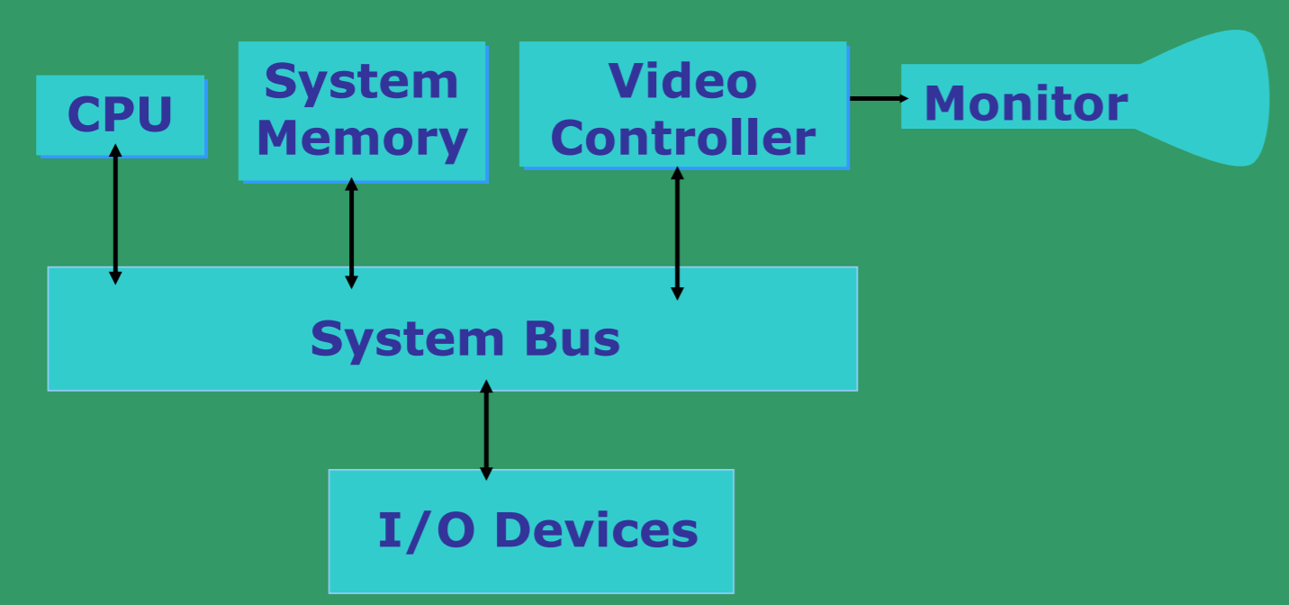
Architecture of a simple raster graphics system

Slide 22
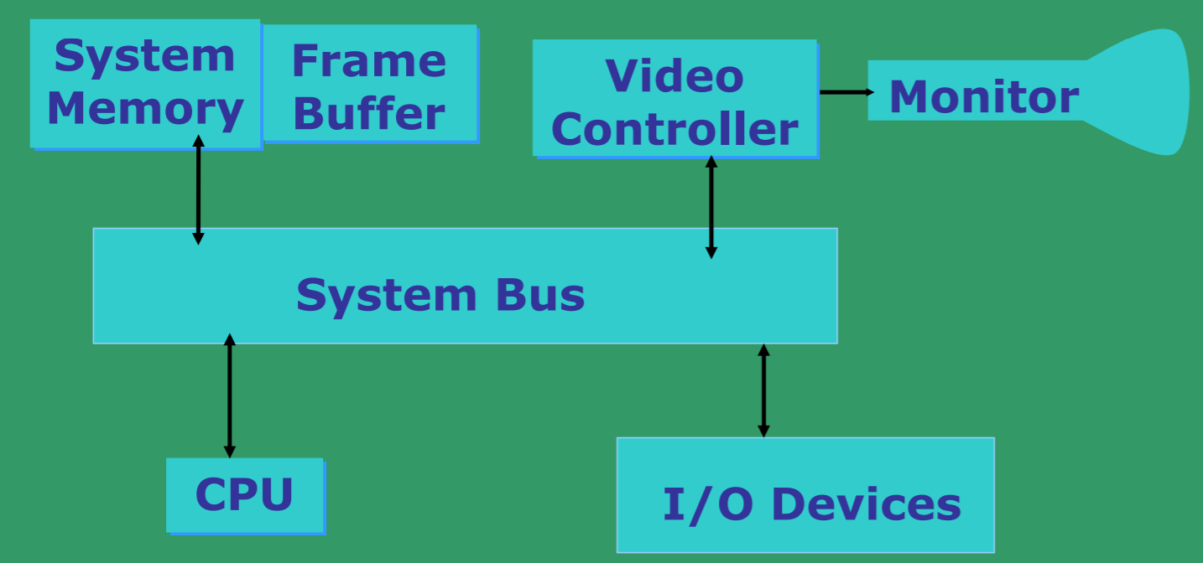
Architecture of a raster system with a fixed portion of the system memory reserved for the frame buffer

Slide 23
Refresh and raster scan display system (contd.)
Entire screen is a matrix of pixels
Each pixel brightness can be controlled
Refresh buffer can be visualized as a set of horizontal raster lines or a row of individual pixels
Line cannot be drawn directly from one point to another
Each point is an addressable point in screen and memory
This causes the effect of ‘aliasing’, ‘jaggies’ or ‘staircase’ effect
Refresh/Frame buffer is also called Bit-plane

Slide 24
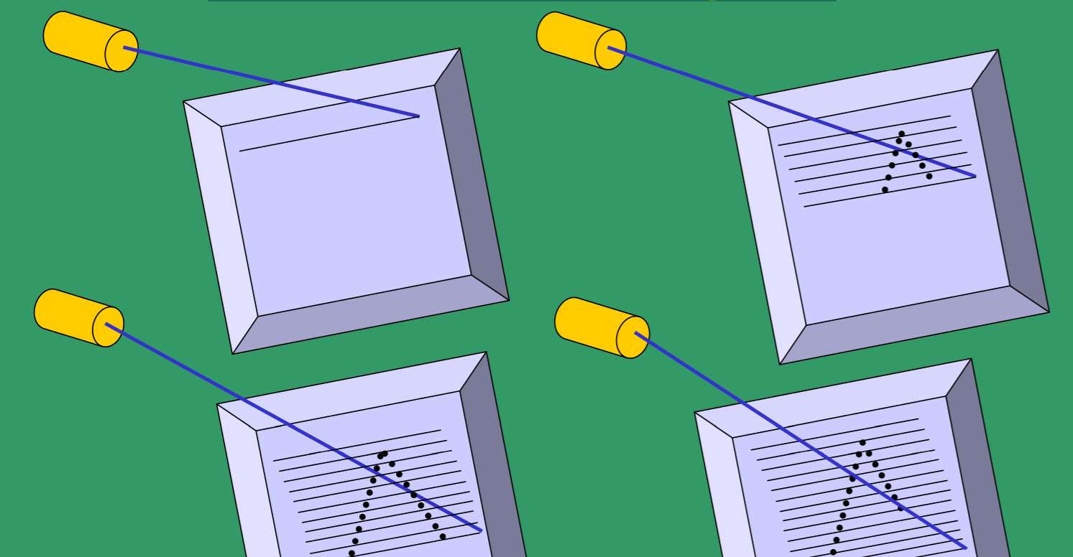
Raster-scan display system draws a discrete set of points

Slide 25
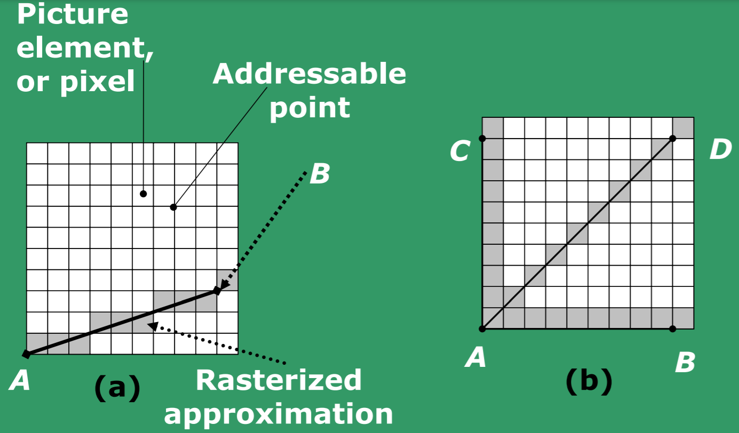
Rasterization: (a) General line ; (b) special cases

Slide 26
Refresh Rate, Video basics and Scan Conversion
Raster is stored as a matrix of pixels representing the entire screen area
Entire image is scanned out sequentially by the video controller (one raster line at a time)
The raster lines are scanned from top to bottom and then back to the top
The intensity of the beam decides the brightness of the pixel
At least one memory bit for each pixel (called bit-plane)

Slide 27
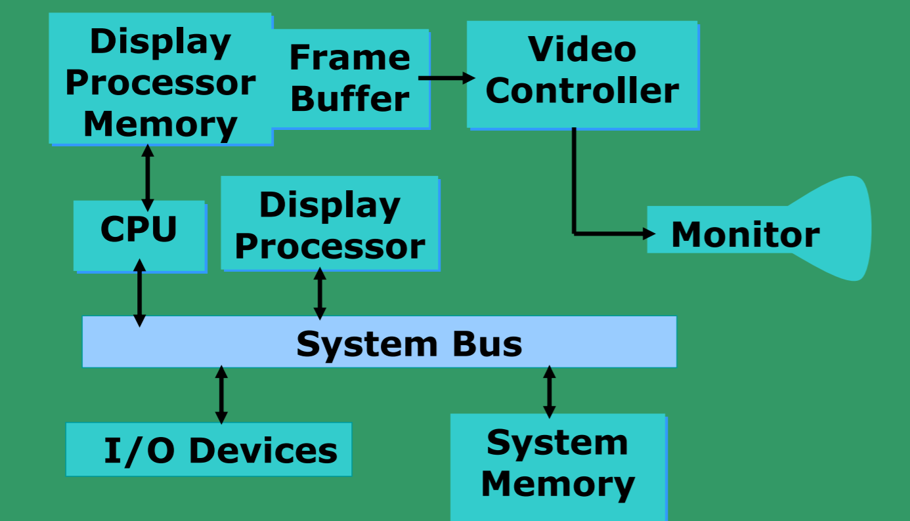
Architecture of a raster-graphics system with a display processor

Slide 28
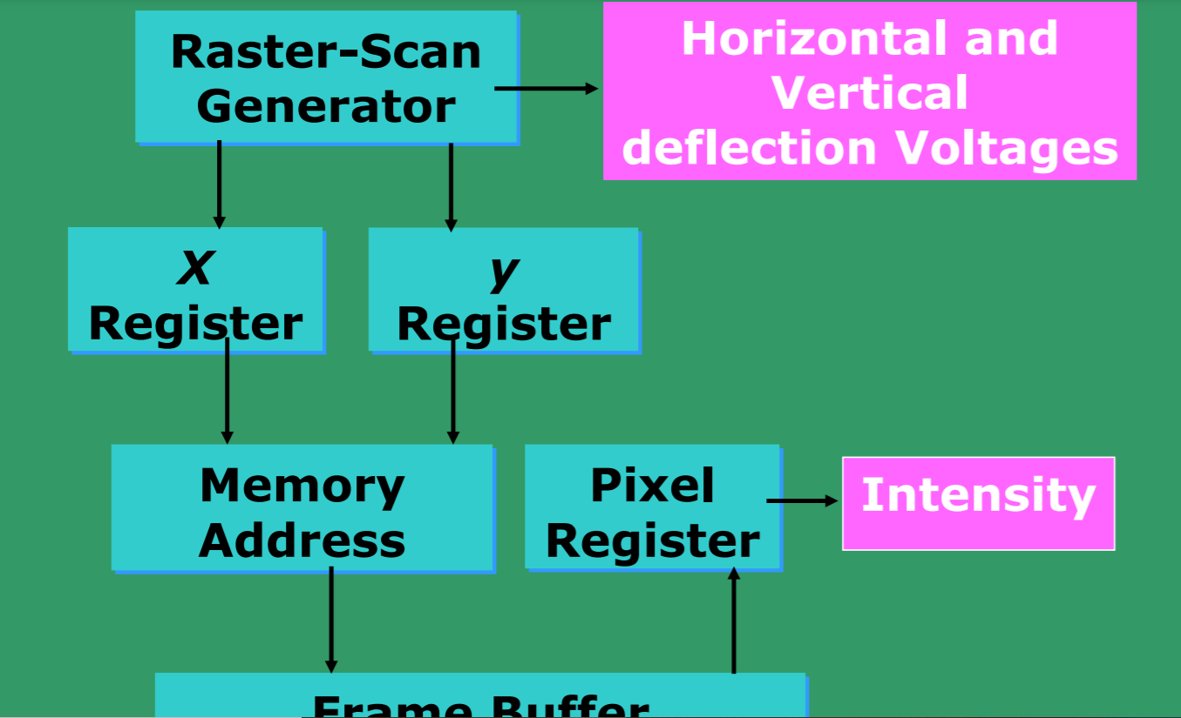
Basic video-controller refresh operations

Slide 29
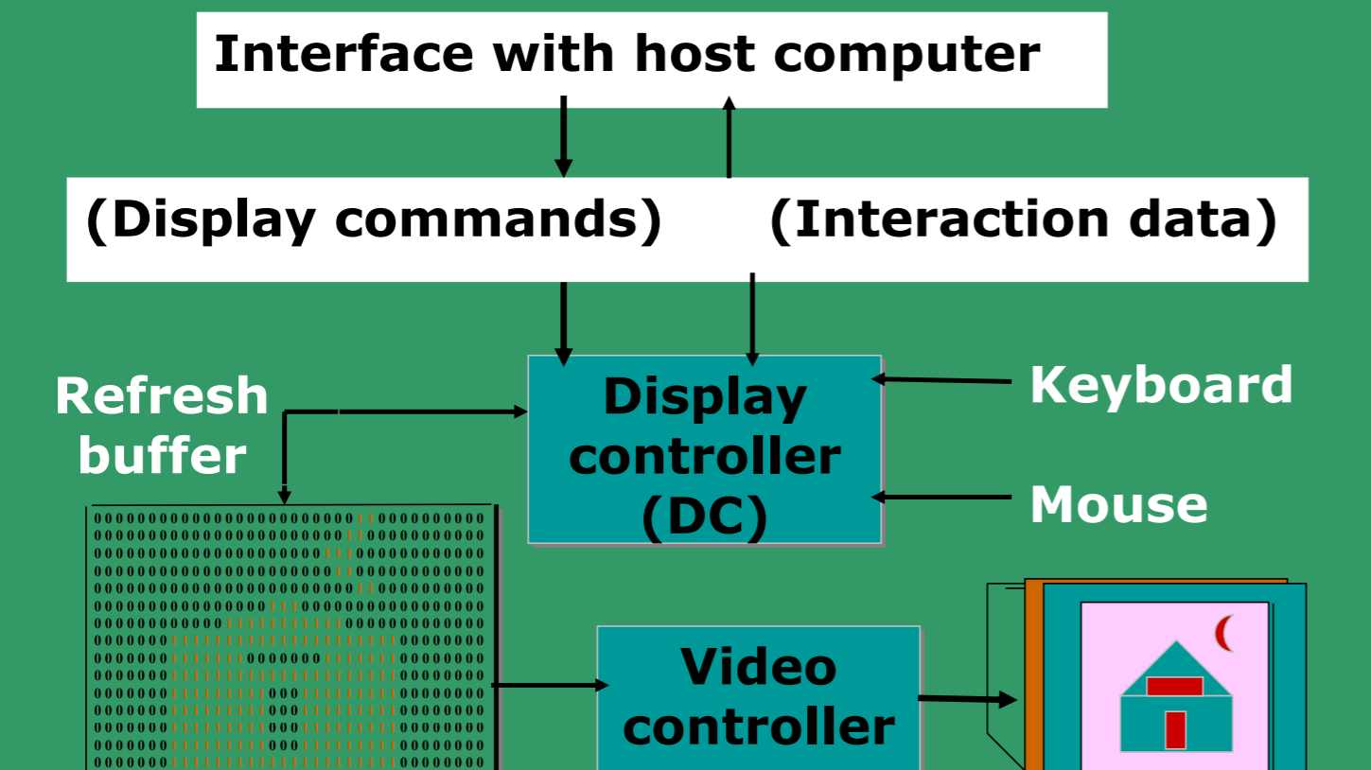
Architecture of a raster display

Slide 30

Raster scan with outline primitives

Slide 31
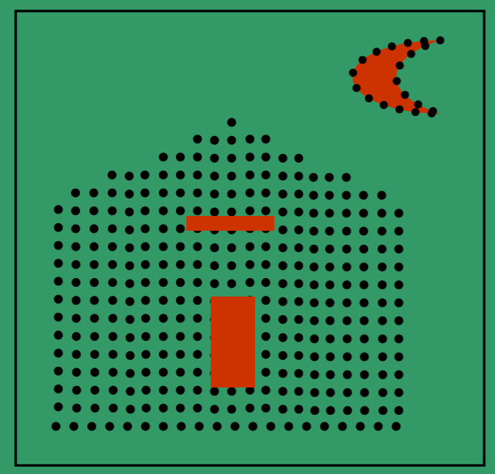
Raster scan with filled primitives

Slide 32
Refresh Rate, Video basics and Scan Conversion (contd.)
A typical example:
If one uses a 512x512 element raster display, then 218 bits are necessary in a single bit plane.
Memory size required: 32 KB
A DAC (digital-to-analog converter) is used to convert the bit value (0, 1) to analog signals for refreshing the screen
Memory size required for N-bit plane gray level frame buffers:
N | Size in KB
3 | 96
8 | 256
24 | 768

Slide 33
Refresh Rate, Video basics and Scan Conversion (contd.)
Refresh rate to avoid flickering – 60 Hz
If one uses a 1024x1024 high resolution CRT:
Even 32 bits per pixel with 1280x1024 pixels raster are available.
N | Display Color | Memory Size
1 | Black and White | 128 KB
8 | 256 colors | 1 MB
24 | 16 millon colors | 3 MB
32 | 16 millon colors | 4 MB

Slide 34
Refresh Rate, Video basics and Scan Conversion (contd.)
Refresh rate of a CRT is the number of times the image is drawn on the screen per second.
Reducing refresh rate increases flicker.
Horizontal scan rate is the number of scan lines the circuit drives a CRT display per second = refresh rate x number of scan lines
Resolution of the screen depends on spot size
CRT resolution is not a function of bitmap resolution
For larger spot size, resolution decreases
Horizontal resolution depends on spot size and beam switching (ON/OFF) speed

Slide 35
Refresh Rate, Video basics and Scan Conversion (contd.)
Bandwidth of the display:
The rate at which the beam can be turned OFF to ON and vice-versa.
For N pixels per scan line, it is necessary to turn the electron gun at a maximum rate of:
N/2 times ON
and N/2 times OFF;
This will create alternate black and white lines on the screen.
Let us now look at some concepts of Video basics and Scan conversion.

Slide 36
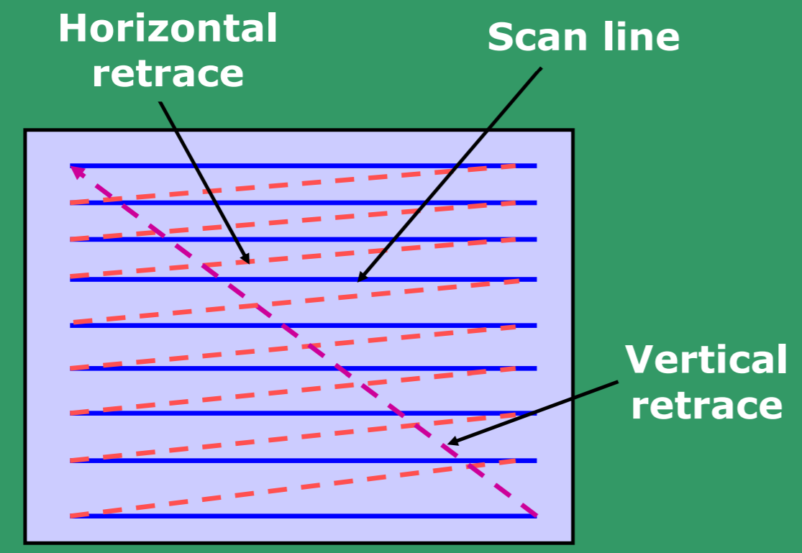
Raster Scan

Slide 37
Refresh Rate, Video basics and Scan Conversion (contd.)
NTSC (American Standard Video) has 525 horizontal lines with a frame rate of 30 fps.
Viewing aspect ratio is 4:3
Each frame has two fields, each containing half the picture.
Fields are interlaced or interwoven
Fields are presented alternately every other 1/60-th of a sec.
One field contains odd scan lines (1,3,5,…)
The other contains even scan lines (2,4,6,…)
Two types of retrace after every field

Slide 38
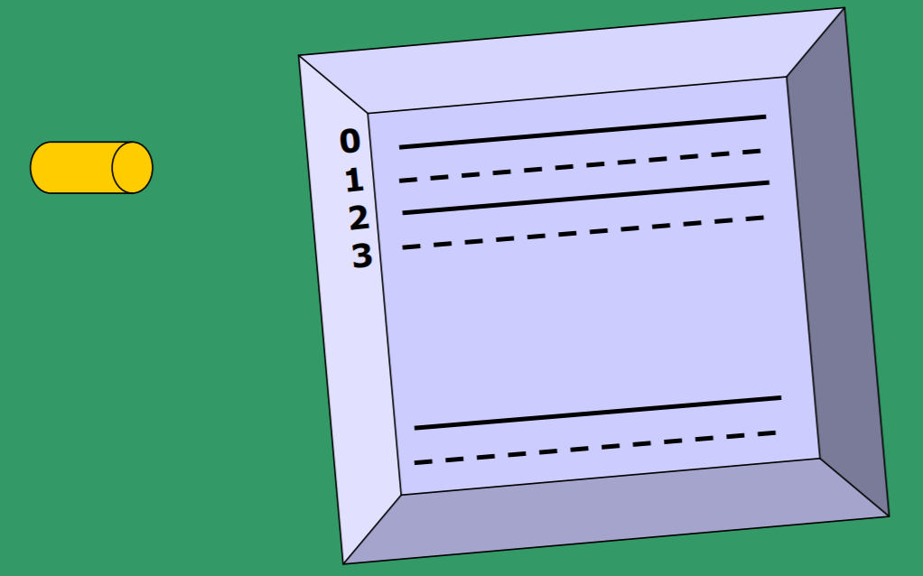
Interlacing scan lines on a raster scan display; First, all points on the even-numbered (solid) scan lines are displayed; then all points along the odd-numbered (dashed) lines are displayed

Slide 39
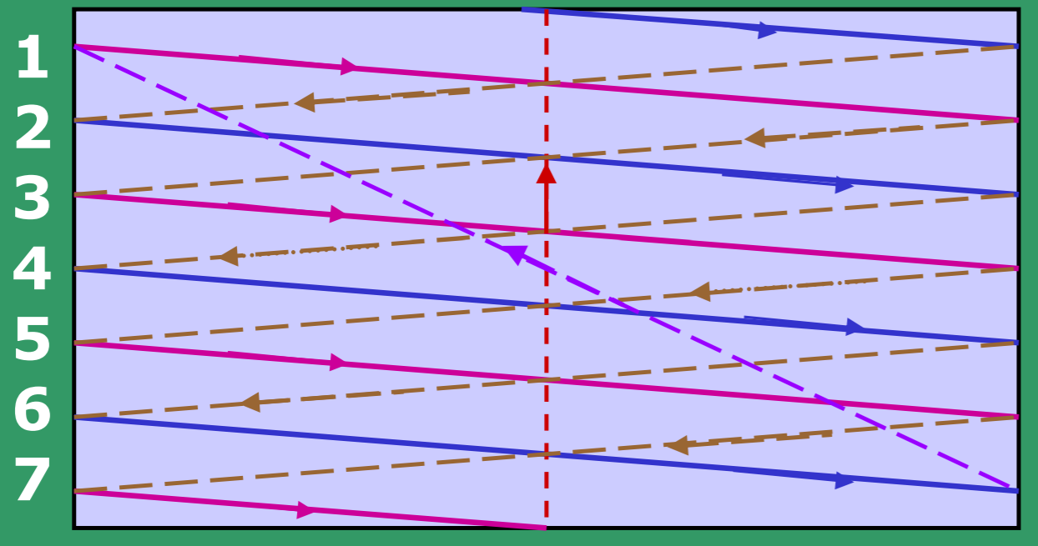
Schematic of a 7-line interlaced scan line pattern.
The odd field begins with line 1. The horizontal retrace is shown dashed. The odd field vertical retrace starts at the bottom center. The even field vertical retrace starts at the bottom right.

Slide 40
Refresh Rate, Video basics and Scan Conversion (contd.)
Horizontal retrace - As the electron beam reaches the right edge of the screen, it is made invisible and rapidly returns to the left edge
• Time taken for horizontal retrace is typically 17% allotted for a scan line.
• After odd field scan conversion is complete, the beam is at the bottom center of the screen.
• After even field scan conversion is complete, the beam is at the bottom right of the screen.
• Odd field vertical retrace returns the beam (switched OFF) to the top center of the screen
• Even field vertical retrace returns it to the upper left corner of the screen

Slide 41
Refresh Rate, Video basics and Scan Conversion (contd.)
Two fields are presented alternately for each frame. So we present 60 frames per second.
In NTSC, generally 483 lines are visible.
This is because, the vertical retrace after each field requires a time equivalent of 21 scan lines
So for each field we have time to display: 262.5 (=525/2) – 21 = 241.5 lines.
So with both fields together, we have: 241.5*2 = 483 lines to display.
This is the reason for 42 (= 525-483) invisible lines.

Slide 42
Refresh Rate, Video basics and ScanConversion (contd.)
Let the time available for each scan line be T.
Thus, we have: T * 525 * 30 = 1 sec.
Thus, T = 63.5 µs/scan-line
This includes the vertical retrace time.
When we consider the horizontal retrace time, the actual time to display all pixels in a scan line (time to scan from left to right only):
T’ = 0.83*T = 53 µs .
• Considering 4:3 aspect ratio, the number of pixels per scan line = 483*4/3 = 644
• Thus, time available for the beam to access and display a pixel = 82.3 ns (nano-second) .

Slide 43
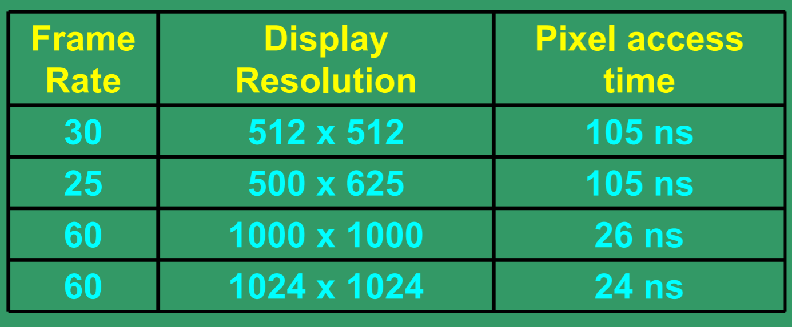
Some examples of pixel access times:

Slide 44
N-bit plane gray level Frame buffer
Choice of the number of gray scales and colors depend on the value of N (bit plane size)
N = 1 – two colors (B&W)
N = 3 – 8 gray scales or colors
N = 8 – 256 gray scales or colors
N = 24 – 16 million colors
• For colored displays (raster-scan), three separate color guns must be used.
• Each bit/byte plane drives a color gun.

Slide 45
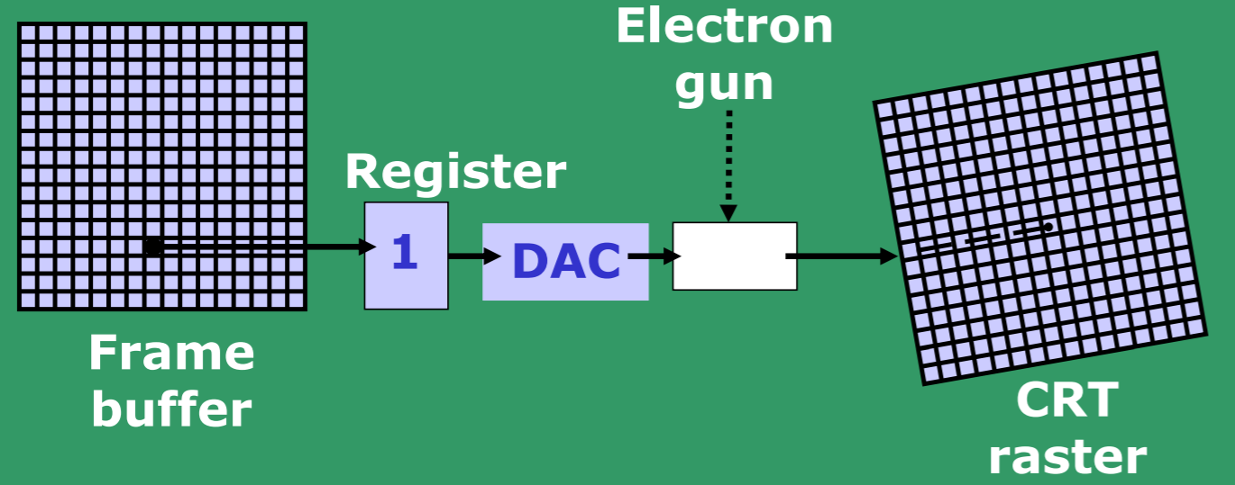
A single bit-plane black & white frame buffer raster CRT graphics device.

Slide 46
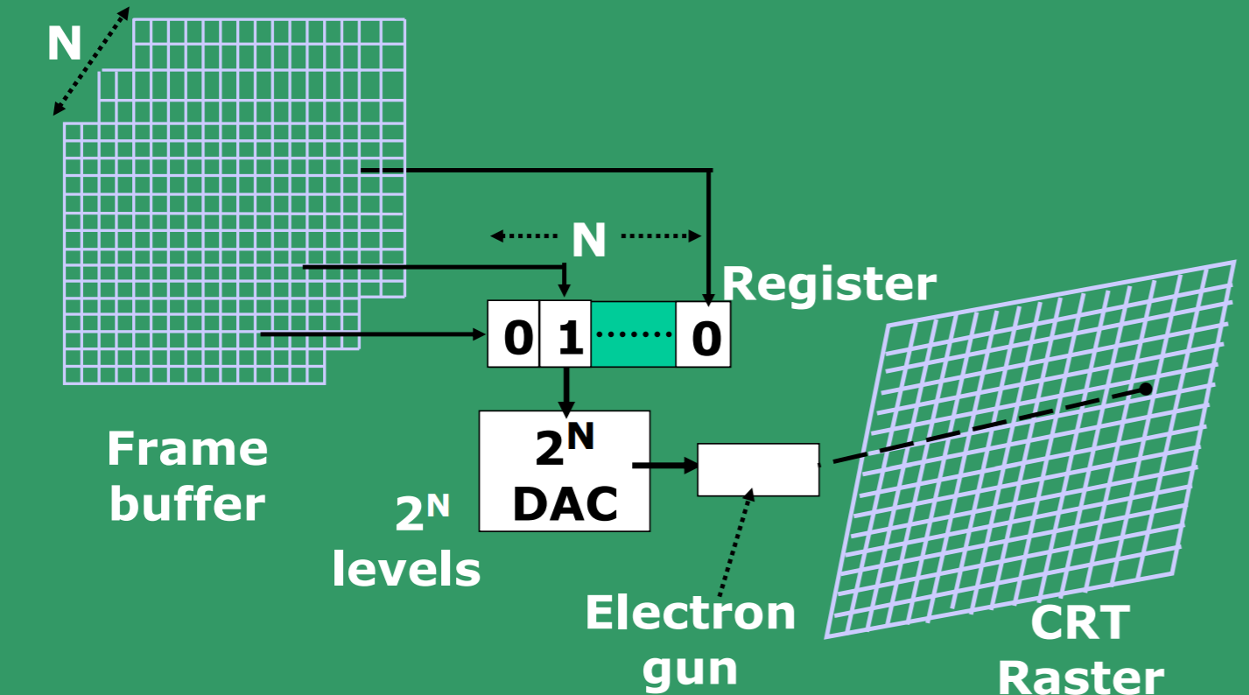
An N-bit plane gray level frame buffer

Slide 47
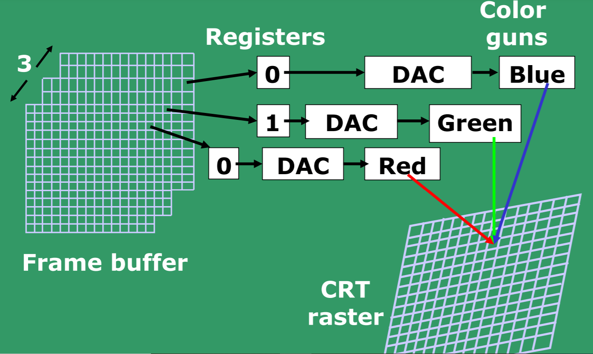
Simple color frame buffer

Slide 48
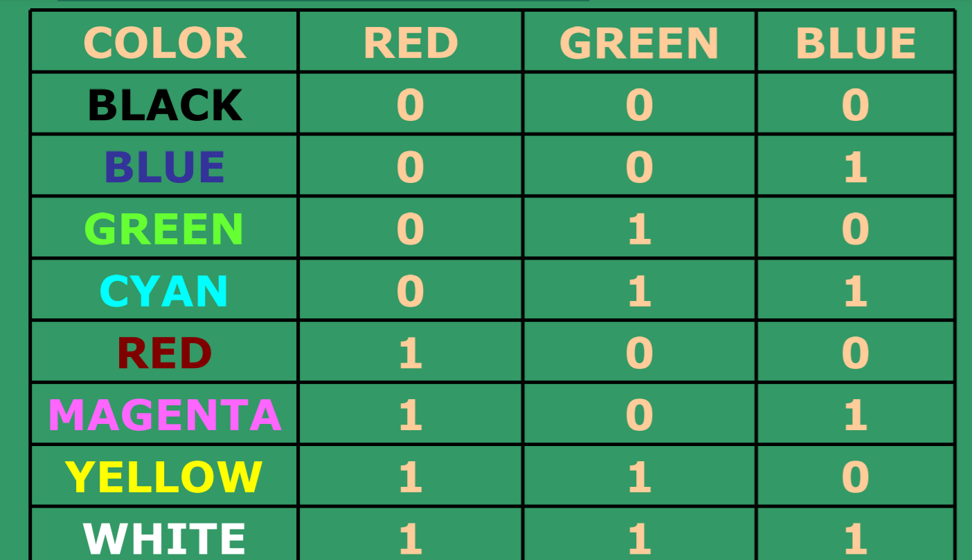
N-bit plane gray level Frame buffer (Contd.)
In case of one-bit for each color frame buffer, we get 8 colors as:

Slide 49
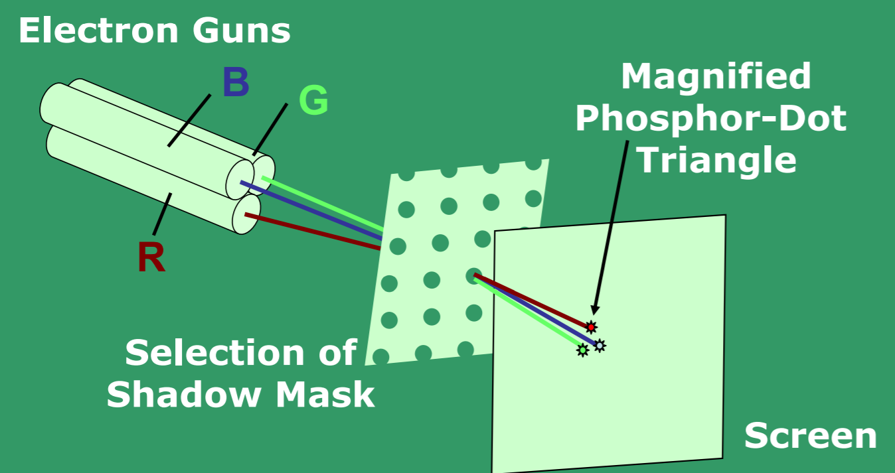
Operation of a delta-delta, shadow-mask CRT. Three electron guns, aligned with the triangular color-dot patterns on the screen, are directed to each dot triangle by a shadow mask.

Slide 50
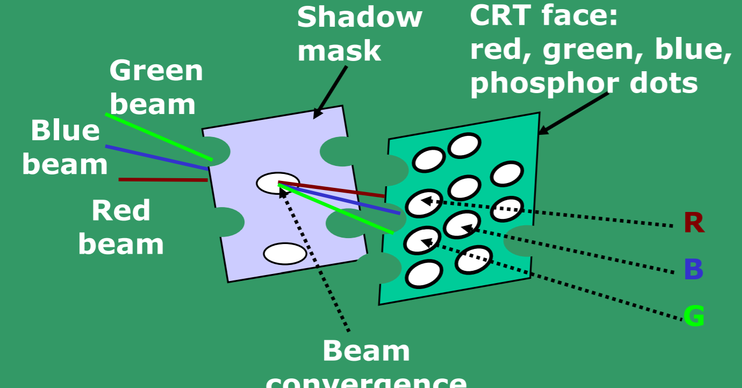
Color CRT electron gun and shadow mask arrangement

Slide 51
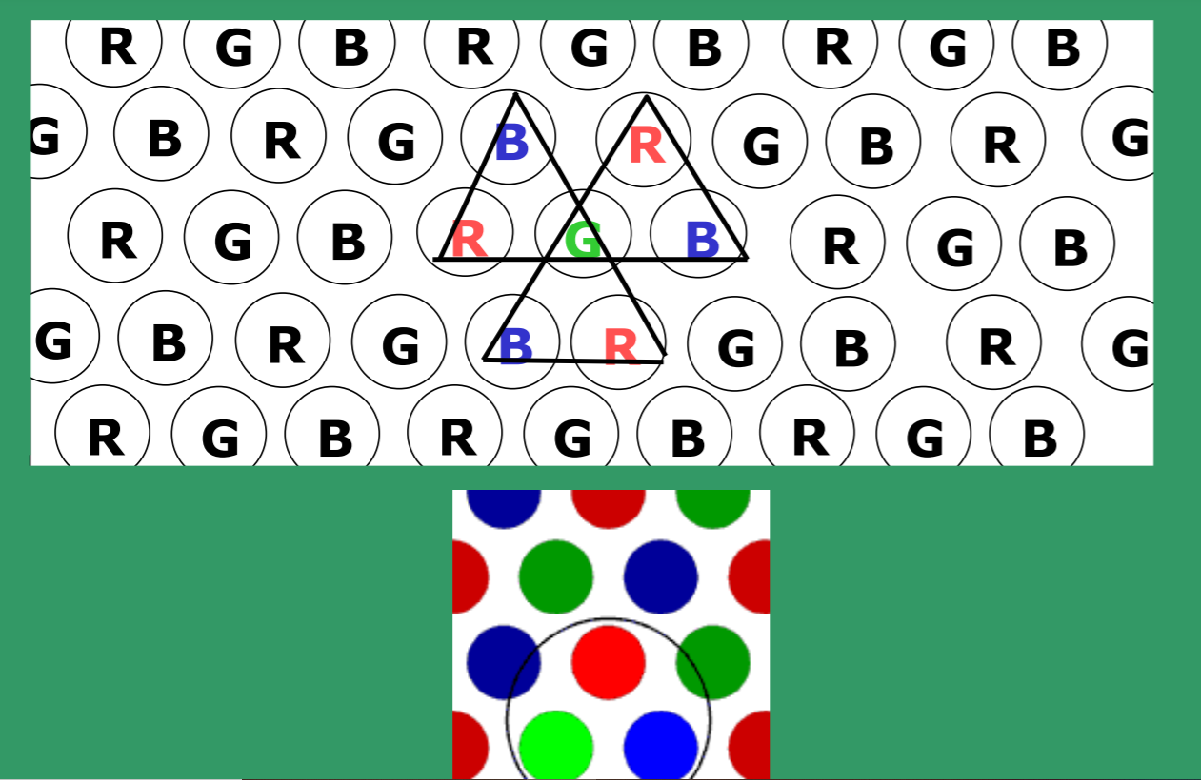
Phosphorus dot pattern for a shadow mask CRT

Slide 52
LCD and FLAT PANEL DISPLAYS
LCD is made up of 6 layers – vertical polarizer plane;
layer of thin grid wires; layer of LCDs; layer of horizontal grid wires; horizontal polarizer; and finally a reflector.
LCD material is made up of long crystalline molecules; When the crystals are in an electric field, they all line up in the same direction.
Active matrix panels have a transistor at each grid point (X, Y). Crystals are dyed up to provide color. Transistors act as memory, and also cause the crystals to change their state quickly.
LCD displays are low cost, low weight, small size and low power consumption

Slide 53
LCD and FLAT PANEL DISPLAYS
The display contains two polarizers, aligned 90⁰ to each other.
With the display in its OFF (or twisted) state, light entering the display is plane polarized by the first polarizer.
This polarized light passes through the liquid crystal sandwich and then through the second polarizer and is reflected back to the display.
Turning the pixel ON (by applying and electric field) causes the crystal to untwist.
Light now passing through the liquid crystal sandwich is now absorbed by the second polarizer. The pixel now appears dark.

